Slide 1
Welcome to the first Lunch & Learn
An introduction to our new blog.
Mmmmm….thank you the chef for lunch and to the admin team for buying ☺

Slide 3
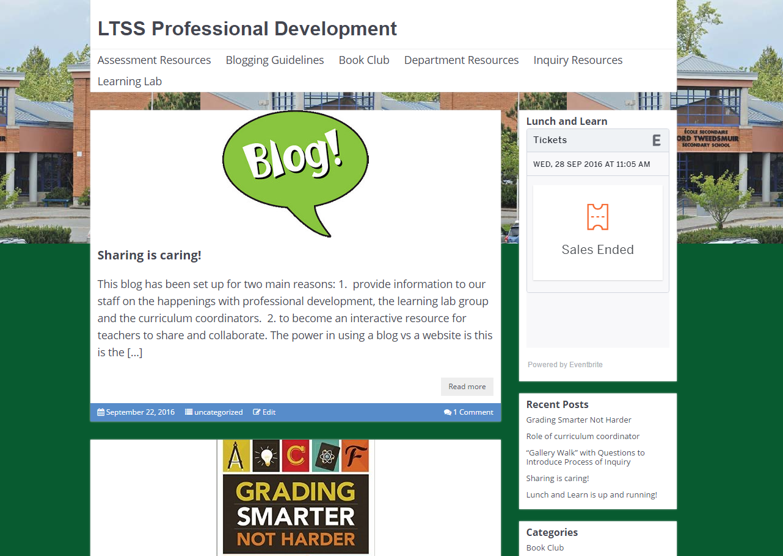
Why a blog for LTS?

Slide 4
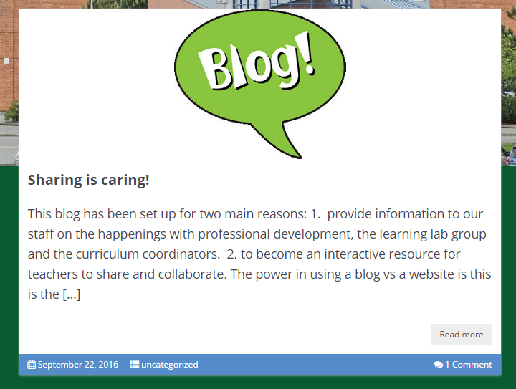
Tap on the safari or Chrome app and go to: ltsssprod.edublogs.org
CLICK HERE

Slide 5
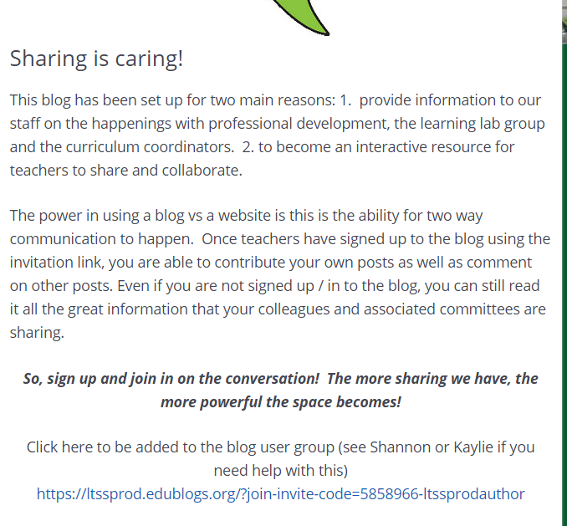
CLICK HERE TO SIGN UP TO BE AN AUTHOR

Slide 6
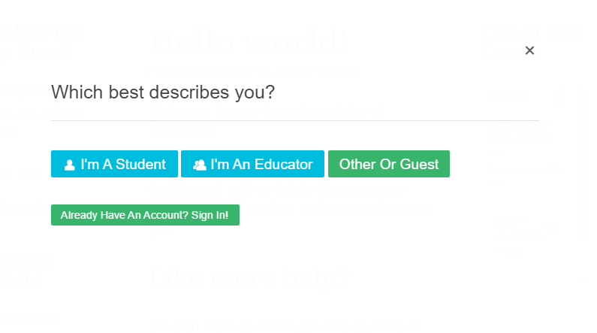
Choose EDUCATOR
Put in your information – work email and username makes it easier to remember
Once you have an account you are able to post, comment and even create your own blog!

Slide 7
Click here to see the ltssprod site, create your own site or to see a list of any sites you are part of
Once you are logged in, you can click here to create a new post

Slide 8
Create your first post
Click on the ‘+’ at the top of the page and choose post
Title the post “your name – lunch and learn practice”
Add some content to the post. Write something interesting about yourself or something you would like to try out in your classroom this year or an idea for a future lunch and learn
See if you can figure out how to set a feature image in your post
hint: google search images, tap and hold to save to camera roll, then in your post dashboard you can add the image by tapping on feature image and pulling it from your camera roll
Choose the lunch and learn category
Press the blue publish button and viola
Click on the site page in the top menu to get back to the site home page

Slide 9
Helpful websites and example blogs
https://help.edublogs.org/
Great resource guides, how to videos and student guides
http://rainoscience.blogspot.ca/
Sample class blog
http://www.edudemic.com/how-and-why-teachers-should-blog/
How and why teachers should blog
http://www.edutopia.org/discussion/9-reasons-why-teachers-should-blog
9 reasons why teachers should blog
https://www.youtube.com/playlist?list=PLq4p3q2fmMYW_Ix1OR6tFT1iFdwiMkf42
A video list of getting started with Edublogs tips

Slide 10
Helpful websites and example blogs
http://www.msdosanjh.com/class-blogs-we-follow
Sample class blog from a Surrey school teacher
https://www.theedublogger.com/check-out-these-class-blogs
List of other sample class blogs
http://www.jordantinney.org/
SD36 CEO / Superintendent Jordan Tinney’s blog
http://georgecouros.ca/blog/archives/3721
5 reasons your students should blog
http://edublogs.org/10-ways-to-use-your-edublog-to-teach/
10 ways to use your blog to teach

Slide 11
Questions? Comments? Ideas?

Slide 12
